Slide 1
Breaking Down Barriers: An Intro to GPU Synchronization Matt Pettineo Lead Engine Programmer Ready At Dawn Studios
Notes:
Hey there, thanks for downloading this talk! I’ve added notes to all of the slides that roughly match what I said during the actual presentation at GDC. So please read along with the notes if you want to get the full experience. ☺

Slide 2
Who am I?
Ready At Dawn for 9 years
Lead Engine Programmer for 5
I like GPUs and APIs!
Lots of blogging, Twitter, and GitHub
You may know me as MJP!
Notes:
So real quick, I just wanted to introduce myself and tell you a bit about what I do and why I’m here today. I’ve been an engine programmer at Ready At Dawn Studios for the past 9 years or so, which is an independent developer located in Irvine, California. I mostly work on graphics/rendering things, but also do quite a bit of general work on our in-house engine. I’ve been the lead of our engine team for the past 5 out of those 9 years. In case it wasn’t already obvious, I really like learning about and discussing GPUs, as well as the APIs that we use to talk to them. Over the years I’ve done a lot of blogging about GPUs and graphical techiniques on my personal blog called “The Danger Zone” (https://mynameismjp.wordpress.com), and I’m also pretty active on Twitter. I have a public repos on GitHub as well, which are mostly samples demonstrating graphical techniques using DX11 and DX12. If you do know me from the internet, then you probably know me as “MJP”.

Slide 3
What is this talk about?
GPU Synchronization!
What is it?
Why do you need it?
How does it work?
How does it affect performance?
Notes:
So why did I get you all in this room today? As you can probably guess from the title of this talk, I’m going to try to give you all an introduction to GPU synchronization using the most gentle and straightforward explanations that I can. Really this is intended for people that aren’t already experts on this subject, and is intended to understandable even if you’re relatively new to graphics programming. So I’m really going to try to start from the basics by explaining what the heck a barrier is, and then moving on to explaining why we even need them in the first place. Afterwards I’m going to also try to explain how they generally work on currently-available GPUs, in particular when it comes to thread synchronization. Finally I also want to help give you all a rough intuition on how (and why) barriers have an adverse effect on performance, which should help you structure things more optimally when using APIs that require manual barrier usage.

Slide 4
Barriers in D3D12/Vulkan
New concept!
Annoying
D3D11 didn’t need them!
Difficult
People keep talking about them
Affects performance
But why? And how?
Notes:
So, barriers are a thing that we have to deal with now. As far as graphics APIs are concerned they’re a (mostly) new concept that came along with the newer “explicit” APIs like D3D12 and Vulkan. If you’ve done any programming with either of those two APIs, you’ve probably realized that barriers can really annoying to deal with. I mean we didn’t have to deal with this at all in D3D11 or OpenGL, so it’s a bit head-scratching that we suddenly have to do all of this manual book-keeping just to get correct results on the screen. They’re also notoriously hard to get right: this is maybe the 4th year that people have gotten up on this stage to talk about barriers and how to get them “right”, and the validation layers seem to always be yelling at us for messing them up. From previous presentations you’ve probably already heard that using barriers will have an affect on your GPU performance, meaning that even if you are getting correct results you still want to optimize them in order to get the best possible frame times. But it may not be obvious at all as to *why* these barriers hurt your performance, and what the exact impact will be. We’re going to go through that bit later on in this talk.

Slide 5
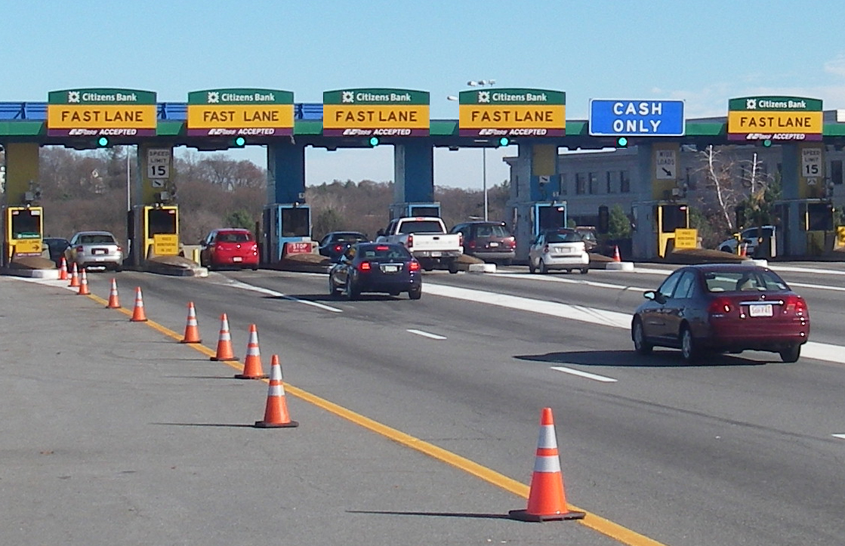
CPU Thread Barriers
Thread sync point
“Wait until all threads get here”
Spin wait
OS primitives
Barrier is a toll plaza
Notes:
Before we talk about the GPU side of things, I thought it might be helpful to talk about barriers as they apply to CPUs. That way those of you with experience in multicore CPU programming can see how the concepts carry over. One kind of barrier you use on the CPU is called a “Thread Barrier”. These are essentially a thread synchronization point, which you use to ensure that all threads have reached a certain point in your code. They’re generally implemented by having threads wait around until all other threads reach the same point, typically by spinning on shared variable or by using an OS-level primitive such as a semaphore. Some very simple code using a thread barrier might look something like this: void ThreadFunction()
{
DoStuff();
// Wait for all threads to hit the barrier
barrier.Wait();
// We now know that all threads called DoStuff()
} The best metaphor I can come up with for this is a toll plaza, except one that’s very slow and causes all of the cars to stop instead of just passing right through.

Slide 6

CPU Memory Barriers
Ensure correct order of reads/writes
Ex: write finishes before barrier, read happens after
Affects CPU memory ops
and compiler ordering!
Barrier is a doggie gate
Notes:
The other kind of barrier that you see a lot in CPU code is called a “Memory Barrier”. These are all about ensuring that low-level CPU memory operations (reads and writes) happen in the order that’s required for your code to work correctly across multiple cores. Probably the most common example is the “mailbox problem”, which is where one thread stuffs some data into one variable (the mailbox) and then sets another variable afterwards indicating to another thread that the mailbox is full:
uint32_t DataIsReady;
SomeStruct Data;
void ThreadFunc()
{
WriteToData(&Data);
// Make sure that all previous writes to Data are complete
// before the write to DataIsReady is visible
std::atomic_thread_fence(std::memory_order_release);
DataIsReady = 1;
}
For various hardware-specific reasons, processors with so-called “weak memory models” (such as ARM or PowerPC) won’t guarantee that the write to the “ready” flag will be seen *after* the write to the mailbox when viewed by code on another core. To make sure this happens, you need to put in a memory barrier. These barriers also inform the compiler that the order of writes is important should be preserved, since the compiler might re-order things if the results are being read by another thread. In this case the visual metaphor is a doggie gate, since a barrier effectively keeps memory operations on one side of the barrier so that they don’t cross over. Some links to look at if you want to learn about memory barriers:
https://docs.microsoft.com/en-us/windows/desktop/DxTechArts/lockless-programming https://channel9.msdn.com/Shows/Going+Deep/Cpp-and-Beyond-2012-Herb-Sutter-atomic-Weapons-1-of-2 https://preshing.com/20120612/an-introduction-to-lock-free-programming/ https://mirrors.edge.kernel.org/pub/linux/kernel/people/paulmck/perfbook/perfbook.html (chapter 15)

Slide 7
What’s The Common Thread?
Dependencies!
Task A produces something
Task B consumes something
Task B depends on Task A
Results need to be visible to dependent tasks!
Notes:
So what’s the common thread between these two kinds of barriers? The answer is that they’re both needed to correctly handle data dependencies. A dependency naturally occurs when one piece of code writes some data, and another piece of code reads from that data. In that case we would say that the second piece of code is dependent on the first bit. Whenever this kind of dependency occurs we need to make sure that the results are *visible* to the dependent code, which essentially means that the dependent code reads exactly the same data that was written.

Slide 8
Single-Threaded Dependencies
int a = GetOffset(); int b = myArray[a];
The compiler + CPU have your back!
Automatic dependency analysis
No need for manual barriers
Expected ordering on a single core
Easy mode
Notes:
When you’re writing single-threaded code you’re naturally producing dependencies, but generally you don’t really have to think about them very much. For instance you might compute an offset into an array, then use that offset to look up some data from that array. You don’t really need to think about this dependency most of the time since this single-threaded case can be handled by the compiler and CPU without manual intervention. The compiler is actually capable of identifying these sorts of dependencies automatically when its looking at a single thread, which means it can do whatever is necessary to make sure that you get the correct results. In terms of low-level memory operations even architectures with weak memory models will produce the correct ordering as long as everything is running on a single core, so you don’t need to worry about memory barriers. Basically this is what I would call “easy mode”, since everything just works without you needing to do anything special.

Slide 9
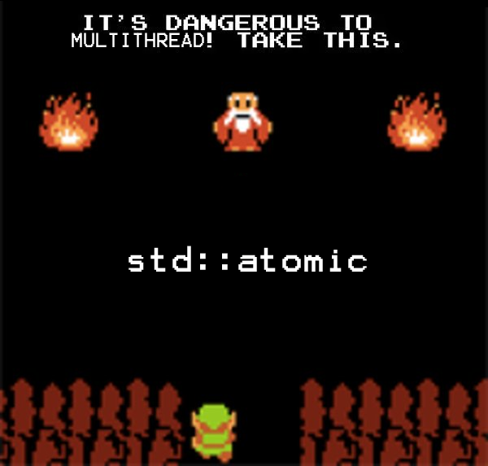
Multi-Threaded Dependencies
Dependencies no longer visible!
Arbitrary numbers of threads
Free-for all memory access
CPU mechanisms break down
Per-core store buffers and caches
Everyone has failed you
You’re on your own
Notes:
Once we get to the multi-core world, suddenly everything is much harder. The main problem here is that once you start writing multiple threads, the dependencies between those threads are no longer visible to the compiler. In general threads are allowed to read and write whatever memory they want within a process’s virtual address space, so it’s not really practical to expect the compiler to magically be able to sort all of that out for you. Multi-core execution is also when CPU mechanisms for ensuring ordering start to break down, and so now you have the issues that come about on architectures with weak memory models. The specifics are a bit too complex to get into here, but some of the reasons for these ordering issues include HW-specific optimizations include per-core store buffers and other specialized caches. Basically what I’m trying to say here is that once you’re writing multiple threads everything else has completely failed you, and now it’s totally on you to start putting barriers and things in the right places if you want to get the results that you expect. In other words you’re Link starting out into a world of scary monsters, and all you’ve got to defend yourself is the atomic library from the standard library.

Slide 10
Task Dependencies
CPU
Core 0
Get Bread
Tasks Overlap!
Core 1
Spread Peanut Butter
Notes:
So let’s look at a really simple example of a multi-core task dependency. On the first core we have a “Get Bread” task, where we need to grab some bread out of the cabinet and put it on a plate. Then on the second core where we have a “Spread Peanut Butter” task where we put peanut butter onto that break we just retrieved. The peanut butter task is naturally dependent on the output of the bread task, which is bad since the peanut butter task starts up before the bread task actually finishes! We would say that these two tasks overlap here, since they occupy the same time period when viewed on a timeline like we have here.

Slide 11
Task Dependencies
CPU
Core 0
Get Bread
No Overlap!
Core 1
Spread Peanut Butter
Barrier
Notes:
To make sure that we get the correct results in this case, we have to stick in a thread barrier that will wait for the bread task to completely finish before allowing the peanut butter task to start. So if we do that, we see the peanut butter task slide over until it no longer overlaps with the bread task. Now we should actually spread the peanut butter on the bread, instead of spreading it onto an empty plate. ☺

Slide 12
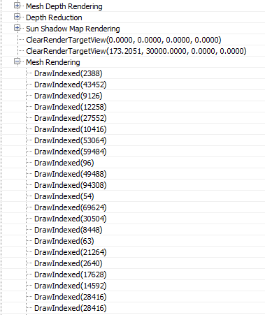
GPU Parallelism
GPU is not a serial machine!
Looks are deceiving
HW and drivers help you out
Notes:
So lets finally switch over to GPU land and talk about what goes on there. At some point or another you’ve probably heard that GPUs are parallel machines with lots of cores on them. Despite that, you may still think of it as a serial machine in terms of how it processes the work you give it. I mean we typically give it commands that look like what we have on the right, where we expect each Clear or Draw or SetRenderTarget to happen sequentially. In fact if you use a GPU debugger such as RenderDoc (pictured here), they will typically let you click on each command to show you the results of each command one after another. It’s important to know that this is *not* at all how a GPU typically works! There’s actually all kinds of parallelism going on under the hood despite the serial nature of rendering APIs, a lot of which is possible because the drivers and the HW itself has of “magic” in there to extract parallelism for you.

Slide 13
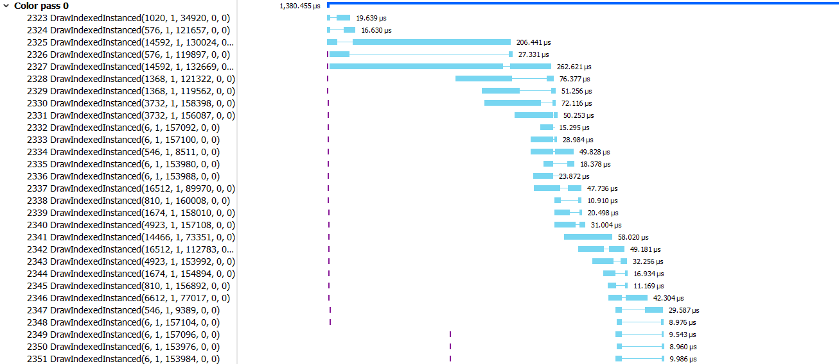
Notes:
Here we have a screenshot from AMD’s Radeon Graphics profiler, which is an awesome tool for checking out the performance characteristics of your app when running on an AMD GPU. This is a “timeline” view, which is showing when each command actually starts executing on the GPU, as well as when it actually finishes. You can see here that these draw calls are definitely not executing sequentially, they’re actually overlapping all over the place (especially the small draws).

Slide 14
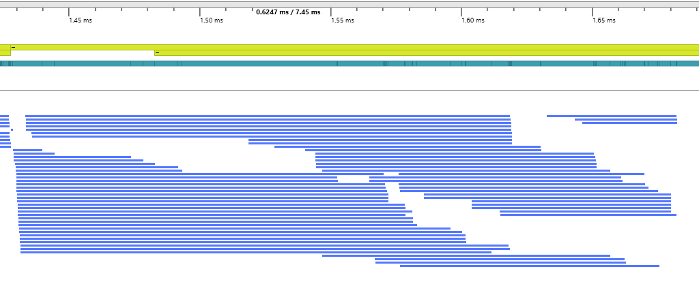
Notes:
This is a similar view from a capture taken with PIX for Windows, which is also showing when a bunch of draws begin and end. This one was taken on an even bigger GPU than the RGP capture from the previous slide, and so you can see there’s even more overlapping going on here.

Slide 15
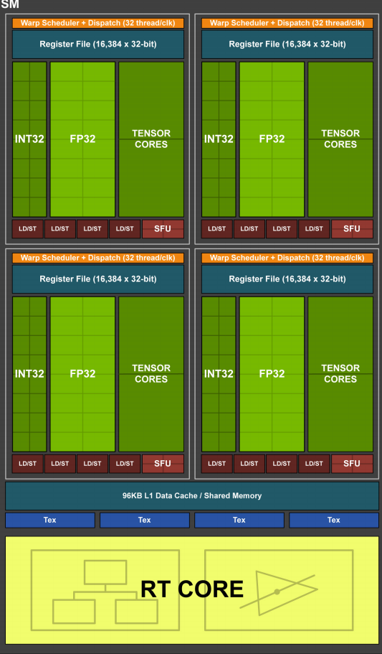
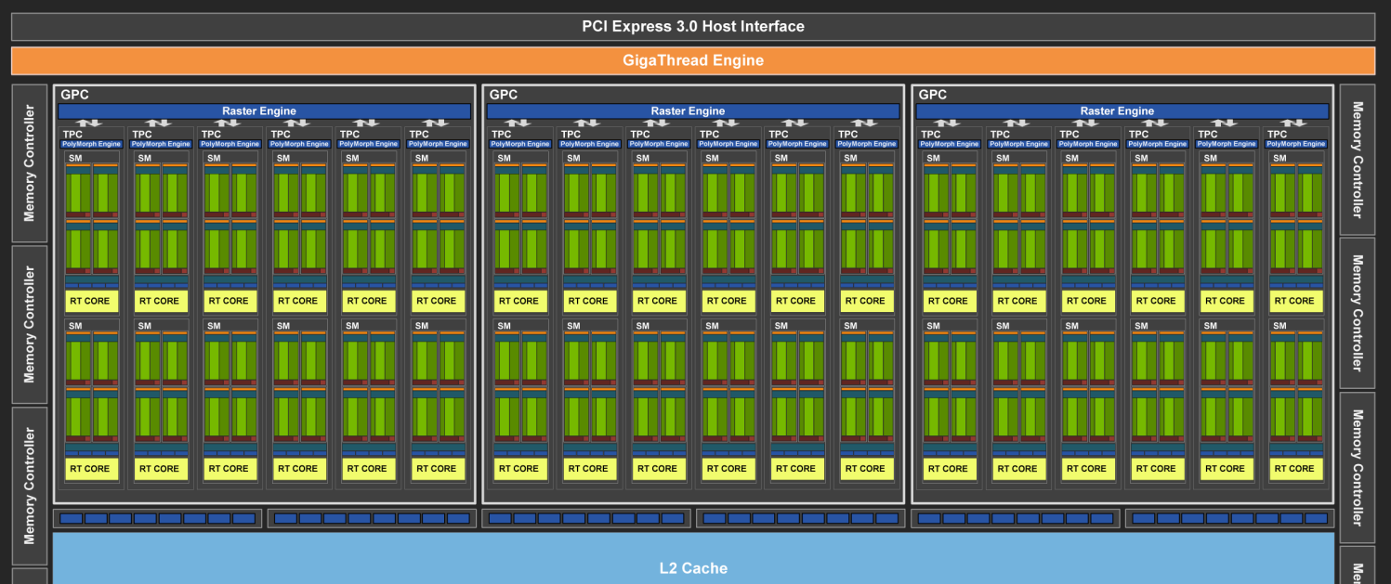
GPUs are Thread Monsters!
Notes:
The reason why we have all of this overlapping going on is because GPUs are big thread monsters! Take a look at this high-level diagram of Nvidia’s latest Turing architecture. Each one of these blocks labeled “SM” is what they call a “Streaming Multiprocessor”. If we zoom in on one of those you’ll see that each SM has 4 sets of 16-wide ALUs, with each ALU capable of running a single “thread” of a shader program. Basically this thing can run *tons* of shaders simultaneously.

Slide 16
GPUs are Thread Monsters!
Lots of overlapping when possible
No dependencies
Re-ordering for render target writes (ROPs)
Overlap improves performance!
More on this later
Notes:
If you’ve got a big hungry parallel monster, then you need to keep it fed with as many threads as possible. And this means overlapping lots of different threads, potentially from completely different draw or dispatch calls. This overlapping of draws/dispatches can occur naturally when there’s no dependencies between them, and in the case of pixel shaders can actually happen because of special hardware on the GPU. The ROP units on typical desktop GPUs are responsible for actually writing to the memory of a render target texture, and these guys can actually take out-of-order output from pixel shaders and put them back into triangle/submission order. This allows the pixel shaders to run out-of-order and overlapped, while still producing the correct results according to the API. We want all of this overlapping to occur because it makes things faster, but we’re going to get into later on.

Slide 17
GPU Thread Barriers
Dependencies between draw/dispatch/copy
Wait for batch of threads to finish
Same as CPU task scheduler
Often called “flush”, “drain”, “WaitForIdle”
Notes:
If the GPU is a big parallel machine that can execute tasks with dependencies between them, then we need some kind of thread barrier in order to avoid overlapping those dependent tasks. GPU operations like Draw and Dispach will generally produce large batches of threads that each process a single work item, and so whenever there’s a dependency we need some sort of mechanism that can wait for the all threads of the previous batch to run to completion before allowing the next batch to start executing. If you’ve ever worked with a CPU-based task scheduler you probably have some sort of mechanism like this for resolving dependencies between tasks. On a GPU you typically have the same thing, just on a much large scale in terms of the number of threads and cores. On the GPU you might also see this kind of barrier called a “flush”, “drain”, or “WaitForIdle”, since they essentially wait for a while bunch of threads to make their way through the entire pipeline.

Slide 18
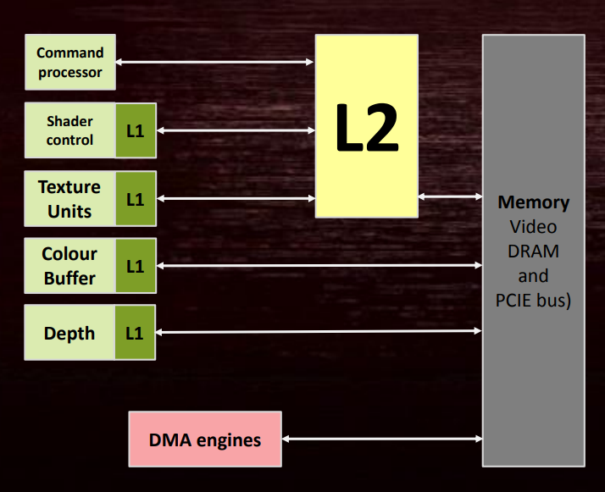
GPU Cache Barriers
Lots of caches!
Not always coherent!
Different from CPU’s
Flush and/or invalidate to ensure visibility
Batch your barriers!
Uh oh
Notes:
Historically, GPUs have lots of small, special purpose caches for various things. This is different from CPUs, which typically have a very straightforward hierarchy. In general GPUs are moving towards more unified cache structures, but there still are a lot of weird cache setups on video cards out in the wild. Another major difference from CPUs is that GPU caches are often not actually coherent with each other. If you look at the diagram on the right (which is from an older AMD presentation detailing a pre-Vega GCN GPU), you can see how there are special L1 caches for memory operations involving render targets and depth buffers. These guys don’t actually go through the big L2 cache, which is a problem if we want to read a color or depth buffer as a texture in a shader. This may require flushing the contents of the color/depth L1 caches to main memory in order to make sure that the writes are visible to shader units, and the L2 may need to be invalidated in case it contains stale data due to writes sitting in the color/depth L1. This is one of several reasons why people always tell you to batch your barriers: flushing a cache once is always going to be faster than flushing it multiple times in a row.

Slide 19
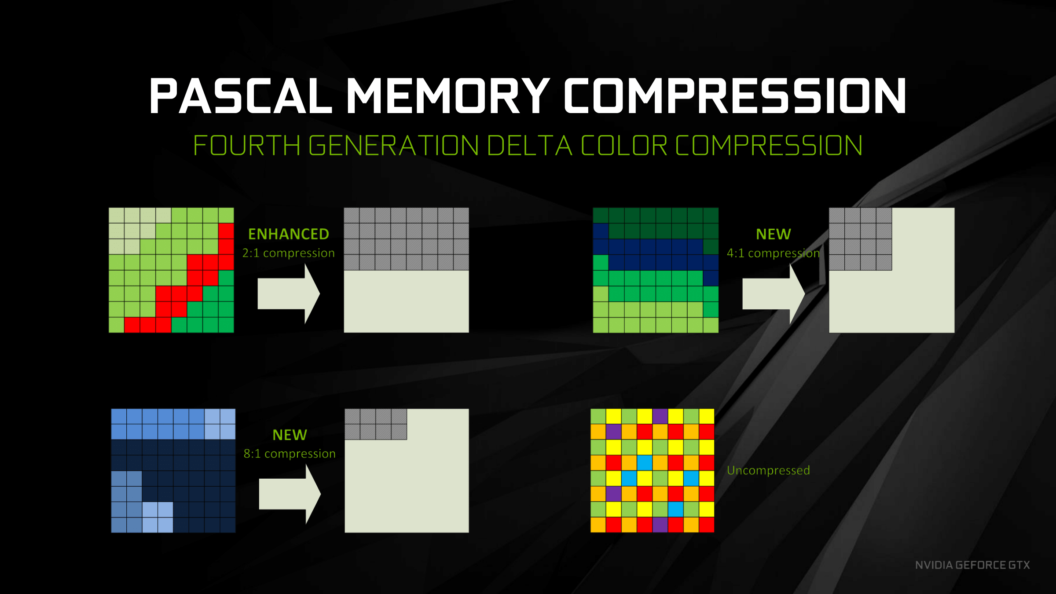
GPU Compression Barriers
HW-enabled lossless compression
Delta Color Compression (DCC)
Saves bandwidth
(may) Decompress for read
Decompress for UAV write
Notes:
A third type of barrier deals with compression and layout changes. GPUs typically have special hardware that allows them to enable lossless compression when writing to render targets or depth buffers, which is typically done to reduce the internal bandwidth required. Nvidia and AMD both employ forms of Delta Color Correction for render targets, which generally work by taking advantage of coherency within a block of pixels. In other cases there can also be special metadata buffers that can indicate if a tile of pixels is in a “clear” state, which saves having to write the actual clear value to the texture prior to rendering. In both cases it may be required to perform decompression operation to write the expanded values to all texels before the render target or depth buffer can be read as a texture, which is something that would happen when a barrier indicates that the resource is going to be read from. It’s also possible that the hardware may not be capable of reading or writing to a compressed resource as a UAV, would may require a mid-frame decompression.

Slide 20
D3D12 Barriers
Higher level - “resource state” abstraction
Texture is in an SRV read state
Buffer is in a UAV write state
Mostly describes resource visibility
Implicit dependencies from state transition
Layout/compression also implied
Notes:
When we work with D3D12, we don’t actually work with low-level barriers. It’s not like you issue commands to flush caches, or decompress buffers. That wouldn’t really make sense for an API that’s meant to work with all kinds of hardware, since those low-level operations reflect hardware-specific details. Instead you work with a higher-level abstraction where the barriers reflect transitions from one state to another. These generally describe the visibility of a resource to a particular part of the logical D3D12 pipeline: for instance you may say that a texture is going to be read by a pixel shader as an SRV, or that buffer is going to be written to as a UAV. These transitions implicitly represent dependencies that the driver can infer, and then convert into the necessary low-level barriers.

Slide 21
Vulkan Barriers
More explicit (verbose) than D3D12
Specifies
Producing/consuming GPU stage
Read/write state
Texture layout
Notes:
Vulkan works at a similar level with its pipeline barriers, which also abstract away the hardware-specific details. However they are a bit more verbose than D3D12, requiring you to explicitly specify the producing and consuming GPU stages, the read or write state, and the texture layout.

Slide 22
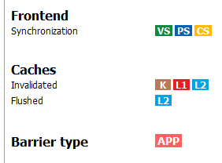
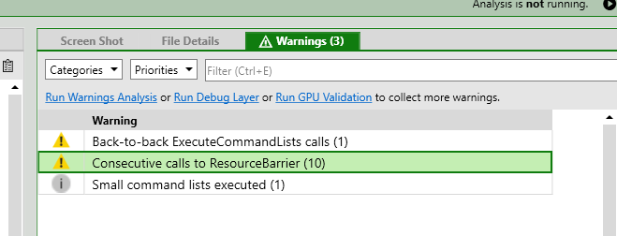
D3D12/Vulkan Barriers
Both abstract away GPU specifics
Both let you over-sync/flush/decompress
RGP will show you!
PIX can warn you!
Notes:
Either way, both D3D12 and Vulkan are abstracting things away from you. But with that said, the drivers are still going to be issuing their low-level barriers as a direct response to the manual barriers that your app is submitting. So you’re still firmly in the driver’s seat here. This means that you can absolutely issue too more barriers than necessary resulting in unnecessary syncing, flushing, or decompressing. The good news is that the Radeon Graphics Profiler will show you what’s going on in response to one of your barriers, as seen in the image on the right. It will show you what kind of thread synchronization operations are occurring, as well as which caches are being flushed and/or invalidated. It will even show you whether the barrier is happening in response to an API barrier, or if its something it had to do implicitly as the result of other API calls. If you’re interested in performance, you should also take a capture with PIX for Windows and look at the warnings tab. It will tell you whenever you’re failing to batch your barriers, and are instead calling ResourceBarrier multiple times in a row with no draw/dispatch/copy calls in between.

Slide 23
What about D3D11?
Driver tracked dependencies!
Like a run-time compiler
Easy mode
Lots of CPU work!
Hard to do multithreaded
Requires CPU-visible resource binding
Incompatible with D3D12/Vulkan!
Notes:
You may be wondering why we didn’t need to deal with any of this barrier stuff back in D3D11. The reason why is because the driver was actually putting them in for you. So there were still syncs and flushes behind the scenes, you just weren’t responsible for manually inserting them. To do this though the driver has to analyze your commands as you submit them to look for dependencies, and then insert in the appropriate barriers as necessary. In that way it was like a run-time compiler, analyzing an entire frame’s worth of commands on-the-fly. Basically it was easy mode, just like single-threaded CPU programming.
So why did we give this up if it was so nice to work with? For starters, it requires a ton of CPU work to figure out all of these dependencies automatically. Everyone wants their games to run fast, and doing this analysis can add significant overhead to rendering. On top of that, this kind of automatic analysis doesn’t play very well with multi-threaded command submission. This is because dependencies can span the chunks submitted different threads, which may require the driver to defer final command buffer generation until it receives and stiches together all of your commands from all threads. Finally, you really need to have all of your resource bindings be visible to the driver if its going to sort out the dependencies for you. The driver can’t know that a draw is going to depend on an earlier dispatch unless the driver can see all of the resources that the draw will read from, which essentially forces into you having some kind of CPU-based binding API like you had in D3D11. This means no GPU-side mechanisms for binding textures, and no bindless-style rendering where all resources are globally visible to a shader. These three things are fundamentally incompatible with the D3D12/Vulkan worldview, which are all about enabling the lowest-possible CPU overhead and supporting multi-threaded command buffer generation.
Side note not mentioned in the presentation: in some cases the barriers were actually implied by the way the D3D11 spec was written. In particular, the spec required that drivers always insert a barrier between draws or dispatches that used a UAV in order to ensure that writes were visible. This is relaxed in D3D12, since you can now manually issue UAV barriers as needed. Nvidia and AMD both actually have extension APIs that can let you disable the auto-barrier after a UAV write, which can let you get better performance.

Slide 24
Let’s Make a GPU!
The Muscle
Current Cycle Count
The Brains
10 cy
Command Processor
Current Command
Shader Cores
Memory
Command Buffer
Thread Queue
Introducing: The MJP-3000
Notes:
With all of that intro material out of the way, I’d like to dive into some more specifics about thread synchronization on GPUs. To do that, I thought it would be more useful if we looked at a simplified example GPU instead of complex real-world example. That way it ill be easier to understand what’s going on, while also not being misleading about how an actual piece of hardware works. So on that note I would like to present to you: The MJP-3000! This beautiful modern marvel of engineering was designed by yours truly, so feel free to reach out after the talk if you think you’d like to license this at AMD or Nvidia. ;)
On the left side you’ll see a part labeled the command processor, which is a unit that process commands from a command buffer one at a time. These commands will result in batches of threads getting deposited in the thread queue immediately to its right. Waiting threads in the thread queue will get pulled out by the shader cores, which is where the shader programs will actually execute and do their work. These programs can then read and write to the memory on the far right side. On the top left there’s also a cycle counter, which will tell you how much time has elapsed when we go through some examples using this GPU.
Broadly-speaking, I would label the command processor as “The Brains”, since it executes the commands and decides which work will actually be done. Meanwhile I would call the shader cores “The Muscle”, since they’re dumb (they can’t tell themselves what to do) but they do all of the heavy-lifting. You may also see me refer to the command processor + thread queue as a “Front-End”, since this is the portion that feeds threads into the shader cores.

Slide 25
MJP-3000 Limitations
Compute only
Only 16 shader cores
No SIMD
No thread cycling
No caches
Notes:
This GPU I’ve designed is considerably simplified compared to a real-world GPU. For starters, this thing can only do compute operations (dispatches). Handling the full rasterization pipeline would add considerable complexity, and I’d like to avoid that. It’s also only got 16 shader cores, which is significantly fewer than your average desktop GPU. There’s also no SIMD for those shader cores, which is commonly used on GPUs to improve throughput. What this means for our examples is that each shader core is considered completely independent, and each can be running a totally separate shader program. On a related note there’s also no thread cycling, which is a technique used on GPUs to hide latency of long operations by switching to another waiting thread. So once a thread starts running on one of our shader cores, it will run to completion. Finally, there’s no caches on this thing. We’re not going to be looking at flushing incoherent caches or anything like that, I mainly just want to talk about thread synchronization.

Slide 26
Simple Dispatch Example
Dispatch 32 threads
Each thread writes 1 element to memory
Notes:
Alright, let’s try going through a simple example on our GPU. Let’s say we want to dispatch 3D threads of a shader program that we’ll call Program A, and each thread of that program will write 1 element to memory. We’ll also say that this program takes 100 cycles to completely finish.

Slide 27
Simple Dispatch Example
0 cy
DISPATCH(A, 32)
NOP
NOP
Notes:
We start out at cycle 0 with a DISPATCH command ready to be executed by our command processor.

Slide 28
Simple Dispatch Example
0 cy
32
Dispatch threads enqueued
DISPATCH(A, 32)
NOP
NOP
Notes:
The command processor immediately deposits 32 threads of program A in the thread queue

Slide 29
Simple Dispatch Example
0 cy
Shader cores execute threads from queue
16
DISPATCH(A, 32)
NOP
NOP
Notes:
The threads in the thread queue then get pulled onto the shader cores, where they actually start executing.

Slide 30
Simple Dispatch Example
100 cy
DISPATCH(A, 32)
16
NOP
Threads write data to memory
NOP
NOP
Notes:
At cycle 100 the first batch of threads have completed their program, and the results have been written to memory.

Slide 31
Simple Dispatch Example
Remaining threads start executing
100 cy
DISPATCH(A, 32)
NOP
NOP
NOP
Notes:
At this point the remaining 16 threads in the thread queue can have their turn on the shader cores

Slide 32
Simple Dispatch Example
200 cy
NOP
NOP
All threads are done writing to memory
NOP
NOP
Notes:
The second batch takes another 100 cycles to finish, so we’re completely finished at cycle 200.

Slide 33
Thread Barrier Example
Dispatch B is dependent on Dispatch A
We can’t have any overlap!
New command: FLUSH
Command processor waits for thread queue and shader cores to become empty
Notes:
Now that we see how things work, let’s try a more complicated example. Let’s say we now have two dispatches, which we’ll call A and B. Threads from dispatch A (colored red) will run first to produce some data, and that data will be read by the reads from dispatch B (colored green). This means there’s a dependency between these two dispatches, which also means that can’t overlap at all! To make sure that all of the data is visible to dispatch B, we need to introduce a new command called FLUSH. When the command processor hits this command, it will sit there and wait for the thread queue and shader cores to become completely empty before it moves on to the next command. This will let us avoid the overlap in this case.

Slide 34
Thread Barrier Example
0 cy
DISPATCH(A, 24)
FLUSH
DISPATCH(B, 24)
Notes:
Let’s see how this actually plays out. We start again with the DISPATCH A command, this time with 24 threads.

Slide 35
Thread Barrier Example
0 cy
8
DISPATCH(A, 24)
FLUSH
DISPATCH(B, 24)
Notes:
This leads to the first batch of 16 threads of program A to start running on the shader cores

Slide 36
Thread Barrier Example
100 cy
DISPATCH(A, 24)
FLUSH
DISPATCH(B, 24)
NOP
FLUSH waits for queue to empty
No overlap!
Cores are idle!
Notes:
If we jump to 100 cycles later, we see that the first batch of threads has completed. We also see that the command processor is sitting on the FLUSH command. This means the command processor will wait until all of the threads from Dispatch A to finish before moving on, which is why there’s no overlap here between A and B. However this also means that 8 of our shader cores are sitting idle, since there’s not enough threads left from Dispatch A to fill them up.

Slide 37
Thread Barrier Example
200 cy
FLUSH
DISPATCH(B, 24)
NOP
NOP
Notes:
At cycle 200 all of the threads from DISPATCH a have finished, so the command processor can finally move on to Dispatch B.

Slide 38
Thread Barrier Example
200 cy
FLUSH
24
DISPATCH(B, 24)
NOP
NOP
Notes:
The 24 threads from Dispatch B get put in the thread queue…

Slide 39
Thread Barrier Example
200 cy
FLUSH
8
DISPATCH(B, 24)
NOP
NOP
Notes:
…and then the first batch of 16 threads start running on the shader cores.

Slide 40
Thread Barrier Example
300 cy
NOP
NOP
NOP
NOP
Notes:
100 cycles later the first patch of threads from Dispatch B have finished, and the second batch can start. Once again half of our cores are idle.

Slide 41
Thread Barrier Example
400 cy
NOP
NOP
NOP
NOP
Notes:
At cycle 400 we’re totally finished and everything is written to memory.

Slide 42
Thread Barrier Example
FLUSH prevented overlap ☺
…but cores were 50% idle for 200 cycles
75% overall utilization ☹
Took 400 cycles instead of 300 cycles
Notes:
So how did it go? The good news is that the FLUSH worked for preventing overlap, and we avoided any race conditions. But the bad news is that our shader cores were 50% idle for 200 cycles, leading to a 75% overall utilization rate for the full 400 cycle period. With peak utilization it would have only taken 300 cycles to execute all of those threads, so we basically have 100 cycles of overhead from the FLUSH.

Slide 43
The Cost of a Barrier
Barrier cost is relative to the drop in utilization!
Gain from removing a barrier is relative to % of idle shader cores
Larger dispatches => better utilization
Longer running threads => high flush cost
Amdahl’s Law
Notes:
This leads us to start to reason about how much it costs to insert a thread barrier like this on a GPU. One intuition we can glean from this is that the cost of a barrier is going to tied to the drop in utilization that’s caused by the barrier. We can also flip that around and realize that the potential game from removing a barrier is going to be relative to the percentage of shader cores that we were leaving idle.
From this we can also reason that dispatches with lots of threads are naturally going to lead to better overall utilization, since they’re going to be able to saturate all of the shader cores on their own with tons of overlapping threads. We can also reason that longer running threads are going to lead to a very high flush cost, since whatever cores they don’t fill up towards the end are going to remain idle for a long period of time.

Slide 44
D3D12/Vulkan Barriers are Flushes!
Expect a thread flush for a transition/pipeline barrier between draws/dispatches
Same for a D3D12_RESOURCE_UAV_BARRIER
Try to group non-dependent draws/dispatches between barriers
May not be true for future GPUs!
Notes:
Whenever you’re issuing a barrier between draws or dispatches in D3D12 or Vulkan, you should fully expect something equivalent to a FLUSH to occur in order to resolve the dependency. The same goes for if you use a UAV barrier to force UAV writes to be visible to subsequent draws or dispatches. To improve utilization you should try to group together non-dependent draws and dispatches between your barriers so that the GPU has more to chew on before syncing. One thing to keep in mind though is that I’m really only talking about currently-available GPUs that are on the market right now. It’s totally possible that future hardware will do things differently, and won’t require the same kind of low-level barriers that we talked about earlier.

Slide 45
Overlapping Dispatches Example
Dispatch B still dependent on Dispatch A
Dispatch C dependent on neither
Let’s try to recover some perf from idle cores
Notes:
Let’s see if we can improve our utilization by overlapping the Dispatch A with some threads from another dispatch, which we’ll call Dispatch C (colored in blue). We can do this because Dispatch C isn’t dependent on either A or B, which means it’s safe to overlap with either of them.

Slide 46
Overlapping Dispatches Example
0 cy
DISPATCH(A, 24)
DISPATCH(C, 8)
FLUSH
Notes:
Once again we start out with Dispatch A, which is followed immediately by Dispatch C in the command buffer.

Slide 47
Overlapping Dispatches Example
0 cy
DISPATCH(A, 24)
8
DISPATCH(C, 8)
8
FLUSH
DISPATCH(B, 24)
Notes:
This causes all of the threads from A and C to get deposited in the thread queue. Dispatch A’s threads get on the shader core first, since that command was processed first by the command processor.

Slide 48
Overlapping Dispatches Example
100 cy
DISPATCH(C, 8)
FLUSH
DISPATCH(B, 24)
NOP
Threads from Dispatch C keep our cores busy!
Notes:
At cycle 100 we see that the command processor is once again sitting on the FLUSH, waiting for all of the threads to finish. But this time we have full utilization for this period, because the 8 threads from Dispatch C were able to take up the remaining cores that were idle last time around.

Slide 49
Overlapping Dispatches Example
200 cy
NOP
8
NOP
NOP
NOP
Notes:
At cycle 200 both A and C have finished, so Dispatch B can start doing its thing.

Slide 50
Overlapping Dispatches Example
300 cy
NOP
NOP
NOP
NOP
Notes:
If we jump 100 cycles later the first batch from Dispatch B has finished…

Slide 51
Overlapping Dispatches Example
400 cy
NOP
NOP
NOP
NOP
Notes:
…and then at cycle 400 we’re completely finished.

Slide 52
Overlapping Dispatches Example
Same latency for Dispatch A + Dispatch B
But we got Dispatch C for free!
Overall throughput increased
Saved 100 cycles vs. sequential execution
75%->87.5% utilization!
Notes:
So how did we do this time? You might notice that the whole sequence still took 400 cycles, which means we had the same end-to-end latency for Dispatch A + Dispatch B. However we were basically able to sneak in Dispatch C for free with no extra processing time. This means that our overall throughput has increased for the whole sequence. If we were to submit A + B + C sequentially with barriers in between each of them it would have taken 500 cycles to complete, so we saved 100 cycles with this approach. Our utilization also jumps up to 87.5%, which is great!

Slide 53
Insights From Overlapping
What if we think of the GPU as a CPU?
Each command is an instruction
Overlapping == Instruction Level Parallelism
Explicit parallelism, not implicit
Similar to VLIW (Very Long Instruction Word)
Notes:
Before moving on, what if we were to take our glasses off and squint a bit while looking at these examples? If we do this, our GPU basically looks roughly like a CPU, where we process individual commands instead of instructions. From this point of view, overlapping our dispatches is basically like achieving Instruction Level Parallelism on a CPU. The catch is that this parallelism is explicit in our case, since we have to carefully order our commands in such a way that they overlap while also using barriers to synchronize. In that way it’s probably more like Very Long Instruction Word architectures, which require the compiler to explicitly identify and schedule parallel operations

Slide 54
Bad Overlap Example
0 cy
DISPATCH(A, 24)
DISPATCH(C, 8)
FLUSH
Notes:
So with the previous example things worked out great because Dispatch C was the perfect size and length to exactly fill in the idle cores during the FLUSH. This is obviously fairly contrived, and you can easily imagine scenarios where this wouldn’t work out so nicely. Let’s try the previous example again, except this time the program for Dispatch C takes 400 cycles to execute instead of 100. We’ll start out again with DISPATCH A…

Slide 55
Bad Overlap Example
0 cy
DISPATCH(A, 24)
8
DISPATCH(C, 8)
8
FLUSH
DISPATCH(B, 24)
Notes:
…and again all of threads from A and B get queued up to run.

Slide 56
Bad Overlap Example
Uh oh
200 cy
DISPATCH(C, 8)
FLUSH
DISPATCH(B, 24)
NOP
Notes:
If we jump 200 cycles into the future we see that something unfortunate has happened: Dispatch A is finished, but the FLUSH is causing the command processor to just sit around and wait for Dispatch C to finish. This is pretty bad since Dispatch C still has another 300 cycles to go, and we’re only hitting 50% utilization.

Slide 57
Bad Overlap Example
500 cy
FLUSH
8
DISPATCH(B, 24)
NOP
NOP
Notes:
We have to jump all the way to cycle 500 before Dispatch C is finally finished, and the command processor can move on to Dispatch B.

Slide 58
Bad Overlap Example
600 cy
NOP
NOP
NOP
NOP
Notes:
100 cycles later the first batch of Dispatch B is finished, and we’re again at 50% utilization.

Slide 59
Bad Overlap Example
700 cy
NOP
NOP
NOP
NOP
Notes:
Then at cycle 700 we’re finally(!) finished.

Slide 60
What Happened?
400 cycles with 50% idle cores
71.4% utilization
1 CP -> 1 queue -> global flush/sync
B wanted to sync on A, but also synced on C
Re-arranging could help a bit
But wouldn’t fix the issue
Notes:
Yikes! That really did not work out for us this time. We had a total of 400 cycles where we were only using half the cores, which drops our overall utilization to 71.4%! The problem we had here was caused by the fact that we only have one front-end here: Dispatch B really just wanted to sync on Dispatch A, but it ended up syncing on Dispatch C as well. Basically a FLUSH is global sync operation, which turns it into a very blunt instrument. In some cases with a similarly long dispatch we could potentially improve things a bit by re-arranging our commands, but in general this is hard to do effectively because we typically don’t know exactly how long a thread will take on a real GPU.

Slide 61

Why Not Two Command Processors?
Notes:
If our problem in that last example was caused by only having one command processor, you might be thinking to yourself “why not just stick another command processor on there?”

Slide 62
Upgrading To The MJP-4000
DISPATCH(D, 8)
24
8
FLUSH
DISPATCH(E, 16)
FLUSH
DISPATCH(A, 24)
24
FLUSH
DISPATCH(C, 8)
Second Front End
FLUSH
Notes:
If you were thinking that, it turns out that the engineers at MJP Industries were way ahead of you. For the next revision of the MJP series they decided to go ahead and stick second front-end in there that feeds into the shader cores. Unfortunately this caused them to blow through their transistor budget, which left no room left on the die for additional shader cores. So we’re still stuck at 16 here.

Slide 63
Introducing The MJP-4000
Two front-ends
Two command processors for syncing
Two thread queues
Two independent command streams
Still 16 shader cores
Max throughput same as MJP-3000
First-come first-serve for thread queues
Notes:
With two front-ends we can effectively process to command streams at once. This is going to work out best if these two streams don’t depend on each other in anyway, so we really want two *independent* command streams to properly feed this thing. We also have to be careful since our max throughput hasn’t increased relative to the MJP-3000, since we still only have 16 shader cores. So we’re not going to do any better for the parts that were already running at 100% utilization.

Slide 64
Dual Command Stream Example
Dispatch A -> 68 threads, 100 cycles
Dispatch B -> 8 threads, 400 cycles
B depends on A
Dispatch C -> 80 threads, 100 cycles
Dispatch D -> 80 threads, 100 cycles
D depends on C
Independent command streams
Notes:
Let’s now go through an example that utilizes both front-ends. We’ll start out with Dispatch A, which this time has 68 threads that take 100 cycles to finish. We’ll follow that up with Dispatch B, which only has 8 thread that take 400 cycles to finish. We’ll say that B depends on A, which means we’ll have to have a FLUSH between them.
Meanwhile we’ll also have Dispatch C, which has 80 threads that take 100 cycles to complete. That will be followed by Dispatch D, which also has 80 threads that take 100 cycles to finish. Dispatch D depends on C, so this will also need a FLUSH.
We can see here that we have two independent command streams, which is exactly what we want for the MJP-4000.

Slide 65
Dual Command Stream Example
0 cy
24
DISPATCH(A, 68)
FLUSH
DISPATCH(B, 8)
First command stream submitted
Notes:
We start out by submitting the first command stream to the top front-end.

Slide 66
Dual Command Stream Example
DISPATCH(A, 68)
50 cy
24
52
FLUSH
DISPATCH(B, 8)
Second command stream submitted
80
DISPATCH(C, 80)
All cores are busy – threads stay in the queue
FLUSH
DISPATCH(D, 80)
Notes:
After 50 cycles, the first batch of Dispatch A’s threads are running on the shader cores, and the remaining 52 threads are in the top thread queue. At this point we submit the second command stream to the bottom front-end. All 80 threads from Dispatch C end up in the thread queue, since the shader cores are all busy at the moment.

Slide 67
Dual Command Stream Example
DISPATCH(A, 68)
100 cy
24
52
FLUSH
DISPATCH(B, 8)
Cores are free –queues will split available cores
DISPATCH(C, 80)
80
FLUSH
DISPATCH(D, 80)
Notes:
At cycle 100 the first batch of Dispatch A’s threads have finished, so the shader cores can pull evenly from both thread queues.

Slide 68
Dual Command Stream Example
DISPATCH(A, 68)
100 cy
24
44
FLUSH
DISPATCH(B, 8)
DISPATCH(C, 80)
72
FLUSH
DISPATCH(D, 80)
Notes:
Dispatch A now has 8 threads running, and Dispatch C uses the remaining 8 cores. Both command processors are also sitting on a flush, waiting for their respective dispatches to finish.

Slide 69
Dual Command Stream Example
DISPATCH(A, 68)
600 cy
24
FLUSH
DISPATCH(B, 8)
DISPATCH(C, 80)
28
FLUSH
Dispatch A has only 4 threads left, but Dispatch C keeps the remaining cores busy!
DISPATCH(D, 80)
Notes:
We now jump way ahead to cycle 600, where Dispatch A is winding down. At this point there are only 4 threads remaining from Dispatch A, which would normally mean that we would have 100 cycles with only 25% utilization. However we have plenty of threads left from Dispatch C to fill those remaining cores, which lets us stay at full utilization.

Slide 70
Dual Command Stream Example
FLUSH
700 cy
24
8
DISPATCH(B, 8)
DISPATCH(C, 80)
12
FLUSH
DISPATCH(D, 80)
Notes:
After another 100 cycles Dispatch A is finally finished, so the top command processor can move on from the flush to Dispatch B. Those 8 threads will have to wait another 100 cycles to actually run though, since all of the shader cores are busy at the moment with threads from Dispatch C.

Slide 71
Dual Command Stream Example
FLUSH
800 cy
24
DISPATCH(B, 8)
DISPATCH(C, 80)
4
FLUSH
Dispatch B can only saturate half the cores, but Dispatch C can fill the rest!
DISPATCH(D, 80)
Notes:
After another 100 cycles the current batch of Dispatch C threads complete, which means B and C can both split the cores. It’s worth noting that the 8 threads from Dispatch B can only fill half the cores, which again would be really bad if we didn’t have Dispatch C in the mix!

Slide 72
Dual Command Stream Example
FLUSH
900 cy
24
DISPATCH(B, 8)
DISPATCH(C, 80)
FLUSH
DISPATCH(D, 80)
Notes:
At cycle 900 Dispatch C is winding down, giving us a brief period with only 75% utilization.

Slide 73
Dual Command Stream Example
FLUSH
1000 cy
24
DISPATCH(B, 8)
FLUSH
72
DISPATCH(D, 80)
Dispatch D continues to keep the remaining 8 cores busy
Notes:
After another 100 cycles the flush on the bottom command processor can finally finish, allowing it to move on to Dispatch D. This lets the threads from Dispatch D fill up the remaining 8 cores that Dispatch B isn’t using, once again bringing us to 100% utilization.

Slide 74
Dual Command Stream Example
FLUSH
1200 cy
24
DISPATCH(B, 8)
FLUSH
48
DISPATCH(D, 80)
Notes:
After another 200 cycles Dispatch B has finished, letting Dispatch D have all of the cores to itself.

Slide 75
Dual Command Stream Example
FLUSH
1600 cy
24
DISPATCH(B, 8)
FLUSH
DISPATCH(D, 80)
Notes:
The whole sequence finally finishes after about 1600 cycles. Whew!

Slide 76

Did Two Front-Ends Help?
It sure did!
~98% utilization!
No additional cores
Lower total execution time for A + B + C + D
Higher latency for A+B or C+D submitted individually
Notes:
So did having two front-ends actually help us in this case? I would say that it absolutely did! We averaged 98% utilization for the whole 1600-cycle sequence, which is fantastic considering we had Dispatch B in there that only had 8 threads and took 400 cycles to finish. If we were to do the naïve version where we submitted all 4 dispatches sequentially on the same front-end with barriers in between, the whole sequence would have taken 1900 cycles to complete and would have achieved only 85% utilization. The one catch here is that the end-to-end latency actually *increased* vs. the sequential version if you were to look at A + B or C + D as individual sequences. This is because the two command streams were sharing the shader cores, causing the dispatches to take longer to fully execute. This can be a concern if you really want low latency for a dispatch, but if you only care about overall frame time then it’s definitely a win.

Slide 77
Even Better For Real GPUs!
Threads stalled on memory access
Real GPU’s will cycle threads on cores
Idle time from cache flushes
Tasks with limited shader core usage
Depth-only rasterization
On-Chip Tessellation/GS
DMA
Notes:
On real-world GPUs this sort of “multi-command-stream” submission can potentially work out even better in some cases. Real shader workloads will often have long stalls where they wait hundreds or thousands of cycles for memory operations to complete, which GPUs like to hide by swapping out the running thread to a different waiting thread (I called this “thread cycling” earlier). Submitting more work from a different front-end can potentially give the GPU more threads to switch to, giving it more ability to hide latency. If you recall the earlier slides, you’ll remember we also mentioned that cache actions like flushes and invalidations are typically a part of resolving dependencies. If one command processor is sitting around waiting for a cache flush, that’s a good opportunity for another command processor to take advantage of those idle cores by launching more threads. There’s also certain workloads that naturally lead to low shader core utilization just due to their very nature. The most common of these is depth-only rasterization, which tends to be bottlenecked by fixed-function rasterization and depth-buffer hardware while only launching very minimal amounts of vertex shader threads. Certain implementations of tessellation and geometry shaders also try to keep all of the work on the same group of shader cores in order to avoid spilling to memory, which can lead to choke points where other groups of shader cores go unused. Finally, GPUs also tend to have fixed-function DMA units that can handle memory transfer operations without using any of the shader cores. If a command processor is waiting for a DMA to finish, that’s another opportunity for some non-dependent work to sneak onto the idle cores and get some work done.

Slide 78
Thinking in CPU Terms
Multiple front-ends ≈ SMT
Simultaneous Multithreading (Hyperthreading)
Interleave two instruction streams that share execution resources
Similar goal: reduce idle time from stalls
Notes:
If we once again try to relate things back to the CPU world, it’s not too much of a stretch to think of multiple front-ends as being roughly analogous to Simultaneous Multithreading (SMT), commonly referred to as Hyperthreading on Intel CPUs. This is a hardware feature of certain CPUs that lets two different instruction streams (threads) share the same set of execution resources of a CPU core. Typically the CPU will try to interleave instructions from both streams in such a way that one thread can actually do some ALU work while the other is sitting around waiting for a cache miss. So really this has the same goal that we had in our examples with the MJP-4000: it’s trying to increase utilization by mixing in an independent command stream.

Slide 79
Real-World Example: Bloom + DOF
Downscale
Downscale
Blur H
Blur V
Upscale
Upscale
Independent command streams
Main Pass
Tone Mapping
Setup
Downscale
Bokeh Gather
Flood Fill
Notes:
Now that we’ve gone over hypothetical examples, let’s look at something you might actually see in a real game engine. This graph shows a fairly typical post-processing setup for a game. We start out with a main pass, which might forward rendered or use a deferred renderer to produce an HDR color buffer. This then gets fed into two different post-processing operations. On top, we have a standard bloom pass that works by downscaling, applying a separable blur, and then upscaling back to full res. Meanwhile we also have depth of field pass going on below that. This might work by first calculating circle of confusion values from a depth buffer, then downscaling to half res, then performing a fancy bokeh-shaped gather, and finally performing a flood fill to fill in gaps in the sampling pattern. Both the bloom and the depth of field both feed into the tone mapping pass, which combines those two effects with the results of the main pass and applies tone mapping to bring everything down to LDR ranges. These bloom and depth of field passes are an ideal case of having two independent command streams: they have dependencies within each stream, but no cross-dependencies between the two streams. This makes it a good fit for submitting them as parallel command streams to two front-ends.

Slide 80
Real-World Example: Bloom + DOF
Command Processor 0
Main Pass
Downscale
Downscale
Blur H
Blur V
Upscale
Upscale
Tone Mapping
Queue-Local Barriers
Setup
Downscale
Bokeh Gather
Flood Fill
Command Processor 1
Cross-Queue Barriers
Notes:
Mapping this post-processing setup to two different front-ends gives us something like this. We now have the bulk of the work scheduled on the top command processor, with a parallel submission on the second command processor for the depth of field. The small purple bars in here are “queue-local” barriers, meaning they only synchronize on the work submitted by that particular command processor. But we also need some heavier cross-queue barriers in order to make this work correctly, since we need to make sure that the depth of field submission doesn’t start processing until the main pass is finished.

Slide 81
Submitting Commands in D3D12
App records + submits command list(s)
With fences for synchronization
OS schedules commands to run on an engine
Engine = driver exposed HW queue
Direct, compute, copy, and video
HW command processor executes commands
Notes:
If we’re working with D3D12, then we have a rather explicit processor for building up command lists and submitting them to the GPU. Basically you’ll record your command list(s), call ExecuteCommandLists to have them run on a particular command queue, and use fences to synchronize your submissions (potentially across multiple queues). When you submit to a command queue, what happens under the hood is that Windows has a GPU scheduler that will manage all in-flight submissions and schedule them on what the Windows Display Driver Model (WDDM) calls an “engine”. In this context an engine is basically a queue that the GPU driver exposes to the scheduler, which typically corresponds to an front-end on the hardware. Each engine has to specify which subset of functionality it supports, which maps exactly the direct/compute/copy command queue types available in D3D12.

Slide 82
Bloom + DOF in D3D12
Command Processor 0
Main Pass
Downscale
Downscale
Blur H
Blur V
Upscale
Upscale
Tone Mapping
Queue-Local Barriers
Setup
Downscale
Bokeh Gather
Flood Fill
Command Processor 1
Cross-Queue Barriers
Notes:
Now if we take our bloom + depth of field example from earlier and map it to D3D12 submissions…

Slide 83
Bloom + DOF in D3D12
GfxCmdListB
GfxCmdListC
Direct Queue
Main Pass
FENCE
Downscale
B
Downscale
B
Blur H
B
Blur V
B
Upscale
B
Upscale
FENCE
Tone Mapping
GfxCmdListA
Setup
B
Downscale
B
Bokeh Gather
B
Flood Fill
Compute Queue
ComputeCmdList
Notes:
…we get something like this. We now have 3 command lists that will run on the direct queue, and possibly use full graphics functionality. Meanwhile we’ll put the depth of field on its own compute command list, and submit on the compute queue towards the bottom. This maps fairly well to existing hardware, where its common to have 1 graphics front-end and multiple compute front-ends. Our “queue-local barriers” now turn into normal transition or UAV barriers, and our cross-queue barriers turn into fences.

Slide 84
D3D12 Multi-Queue Submission
Submissions to multiple command queues will possibly execute concurrently
Depends on the OS scheduler
Depends on the GPU
Depends on the driver
Depends on the queue/command list type
Similar to threads on a CPU
Notes:
It’s important to keep in mind though that submitting to multiple command queues doesn’t guarantee that your submissions will actually execute in parallel like our MJP-4000 example! It really depends on a whole bunch of factors that include the OS scheduler, the hardware resources of the GPU, how the driver exposes things, and what type of command list you’re submitting. It’s actually very similar to threads on a CPU: executing things on multiple threads doesn’t guarantee that they’ll actually execute at the same time on multiple cores, you can easily just have two threads sharing the same core that switches back and forth.

Slide 85
D3D12 Virtualizes Queues
D3D12 command queues ≠ hardware queues
Hardware may have many queues, or only 1!
The OS/scheduler will figure it out for you
Flattening of parallel submissions
Dependencies visible to scheduler via fences
Check GPUView/PIX/RGP/Nsight to see what’s going on!
Notes:
This ambiguity regarding command list execution is possible because D3D12 and the OS actually virtualize the command queues. Each ID3D12CommandQueue that you create doesn’t correspond directly to some hardware queue or front-end: in fact you’re allowed to created as many command queues as you want. The scheduler is responsible for taking all of your submissions and making sure that they execute on *some* hardware queue, of which there might only be 1! The scheduler can do this by “flattening” your submissions if necessary, which basically amounts to serializing your multiple executions and running them sequentially. This sort of thing is possible because the API is setup in such a way that cross-queue synchronization is only possible in-between command list submissions, and not in the middle of them. It’s also made possible by the fact that the dependencies between submissions are made visible to the OS scheduler through your fences, which are actually quite heavyweight since they tie into the scheduler.
If you want to see what’s actually going on, you should definitely use your tools! GPUView is specifically designed to view command buffer submission activity on both GPU and CPU timelines, and can be utilized by taking an ETW capture (the easiest way to do this is to use Bruce Dawson’s UIforETW tool: https://github.com/google/UIforETW). PIX for Windows also has a cool timing capture feature (https://devblogs.microsoft.com/pix/timing-captures/) that can show you your submissions are executing, and can also show you how your fences are causing waits. The vendor specific tools from AMD and Nvidia also have their own timelines and trace views that can be really helpful for seeing how your command lists are stacking up.

Slide 86
Vulkan Queues Are Different!
They’re not virtualized!
…or at least not in the same way
Query at runtime for “queue families”
Vk queue family ≈ D3D12 engine
Explicit bind to exposed queue
Still not guaranteed to be a HW queue
Notes:
For any of those using Vulkan (or considering using it), you should be aware that the way Vulkan handles queues is actually a bit different. In Vulkan you can’t simply create as many queues as you want: you instead have to query the device to see how many queues of a particular “family” are supported by the device, and then you have to explicitly bind to one of those slots. This gives the driver an opportunity to roughly inform you of the resources available on the actual hardware, which lets you make some decisions based off of that. The downside is that your app needs to adapt on the fly and handle flattening itself for cases where there aren’t as many queues available as you might expect, whereas in D3D12 the OS will just figure things out for you. And of course there’s still no guarantee that the Vulkan queue slots explicitly map 1:1 with a hardware front-end, so there’s still some virtualization possible here.

Slide 87
Using Async Compute
Fills in idle shader cores
Just like our MJP-4000 example!
Identify independent command streams
…and submit them on separate queues
Works best when lots of cores are idle
Depth-only rendering
Lots of barriers
Notes:
The kind of submission setup that I described earlier with the bloom + depth of field is commonly referred to as “async compute”, which you’ve probably heard of. This generally refers to having one main “graphics” submission, and one or more compute-only submissions to other queues. It was popularized by AMD, since their hardware tends to have 1 graphics front-end and lots of compute-only front-ends. However it also works on Nvidia hardware, which also has multiple compute-only queues (Intel so far only exposes a single graphics queue and no other queue types). The goal is exactly what we did earlier in our MJP-4000 example: to throw in some independent command streams that file in the idle cores whenever there’s bubbles. They key to using it effectively is to identify strings of commands that are non-dependent, and then separating them into their own command lists and submissions. Since it’s all about filling in idle cores, you’re generally going to get the most bang for your buck by targeting points in your frame that have low shader core utilization.

Slide 88
Recap
Notes:
Alright, we’re almost at the end! But first I want to give a quick recap to make sure that I emphasize the important points that I want you to take away from this talk.

Slide 89
GPU Barriers Ensure Data Visibility
Probably involves GPU thread sync
Maybe involves cache flushes
Maybe involves data transformation
Decompression
API barriers describe visibility + dependencies
Think about your dependencies! (or visualize them!)
Notes:
The first major takeaway here is that GPU barriers are all about ensuring data visibility in the case of dependencies. On current GPUs this is generally going to involve some kind of GPU-wide thread synchronization operation, and could potentially involve some kind of cache action and/or data transformation (particularly in the case of decompression).
Since barriers are all about dependencies, it’s critical that you’re always thinking about your dependencies within a frame. Using a tool like DOT to visualize your dependencies can help you figure out where your choke points are, and also how you might re-arrange things to get better utilization. You can also consider using “frame graph” techniques to automatically discover your dependencies and submit your commands with optimal barriers https://www.ea.com/frostbite/news/framegraph-extensible-rendering-architecture-in-frostbite https://www.gdcvault.com/play/1024656/Advanced-Graphics-Tech-Moving-to https://ourmachinery.com/post/high-level-rendering-using-render-graphs/

Slide 90
GPUs Aren’t That Different
Command processor = task scheduler
Shader cores = worker cores
Multi-core CPU’s have similar problems!
Parallel operations
Coherency issues
Notes:
The next major takeaway here is that GPUs aren’t really *that* different from multi-core CPUs. They have their own quirks, but at least in terms of thread synchronization you have to deal with a lot of the same issues. It’s not too far off to think of your command processor as a hardware task scheduler, with the shader cores being the work cores/threads that a task scheduler will throw work at.

Slide 91
Barriers = Idle Cores
Keep the thread monster fed!
Waits/stalls decrease utilization
Careful barrier use => higher utilization
Watch out for long-running threads!
Batch your barriers!
Flushing cache once >>> flushing multiple times
Notes:
When it comes to barriers, they’re almost always going to cause some kind of bubble where there’s no work happening on your shader cores. The thread monster is always hungry, and you should do your best to minimize the periods where no threads are running. You can achieve this by being very careful about your barrier usage, and also trying to avoid scenarios where you’re syncing on a draw or dispatch wither small numbers of very long-running threads. And of course you should always always always batch your barriers, since flushing or syncing once is always going to be faster than doing it multiple times in a row.

Slide 92
Using Multiple Queues
Parallel submissions may increase utilization
Not guaranteed! – check your tools!
Won’t magically increase the core count
Look for independent command streams
Don’t go crazy with D3D12 fences
Notes:
Finally, if you’re going to try to use multiple queue submissions to improve your utilization, then you should actually make sure that you’re getting the desired result! With D3D12 in particular there’s no guarantee that your submissions will actually run in parallel, and the hardware may have some quirks to prevent things from overlapping properly. Your GPU tools are definitely going to be your friends if you’re attempting to do this. Also, keep in mind that using multiple queue submissions isn’t going to magically increase the number of shader cores on the GPU. If you’re already saturating all of the cores, then you’re not going to be able to meaningfully increase the throughput. In fact you might actually just make things worse in that case by increasing cache contention, or even making it more difficult to properly time different passes since they’ll be sharing the GPU. If you are going to try to use multiple queues, you’ll want to look for sequences of commands that are independent from other sequences of commands within your frame. Just be careful not to go crazy with the number of submissions and fences! Both can have a lot of overhead for both the CPU and GPU, and you so you’ll generally want to stay away from lots of submissions that only do a small amount of work.

Slide 93
That’s It!
Thanks to…
Ste Tovey
Rys Sommefeldt
Nick Thibieroz
Andrei Tatarinov
Everyone at Ready At Dawn
Notes:
Alright, that’s the end of the talk! I wanted to give a quick shout-out to the people from AMD and Nvidia that helped me get this talk into the conference, and also provided me with a lot of helpful advice and feedback. I also wanted to thank everyone at Ready at Dawn, especially those that came to my dry-run and gave me feedback.

Slide 94
Contact Info
matt@readyatdawn.com
mpettineo@gmail.com
@mynameismjp
https://mynameismjp.wordpress.com/
https://github.com/TheRealMJP/GDC2019_Public
Includes pptx and PDF with full speaker notes
Notes:
If you have any questions, comments, or feedback, please don’t hesitate to reach out! I put both my work and personal email up here, along with my twitter handle, blog, and GitHub page. If you’re interested in a long-form in-depth version of the material that I presented here, feel free to head over to my blog where I have a 6-part series on this subject: https://mynameismjp.wordpress.com/2018/03/06/breaking-down-barriers-part-1-whats-a-barrier/ Thanks again for downloading and reading this!

